Slide 1
Photography I for Non-Majors
FINAL PROJECT
By: Kayla Rodriguez

Slide 2
Sublimity
Concepts
Ideas:
Minimalism
1-2 subjects per photo
Perfection
and
Superiority
Contradicting concepts to make a larger argument
These make a statement
Naturalism and Imperfection
High contrast
Bold Colors
Reflection

Slide 3
WHY I WANT TO EXPLORE THESE IDEAS
AESTHETICS
I want to create an abstract way of viewing idea of perfection and imperfection in a conventional way
LIFE EXPERIENCES
I like many others experienced rejection in society for having differing views; I’m very passionate about individualism
IMPACTFULNESS
I want this shoot to speak to younger and older audiences who feel the societal pressure to “act” or “look” a certain way

Slide 4


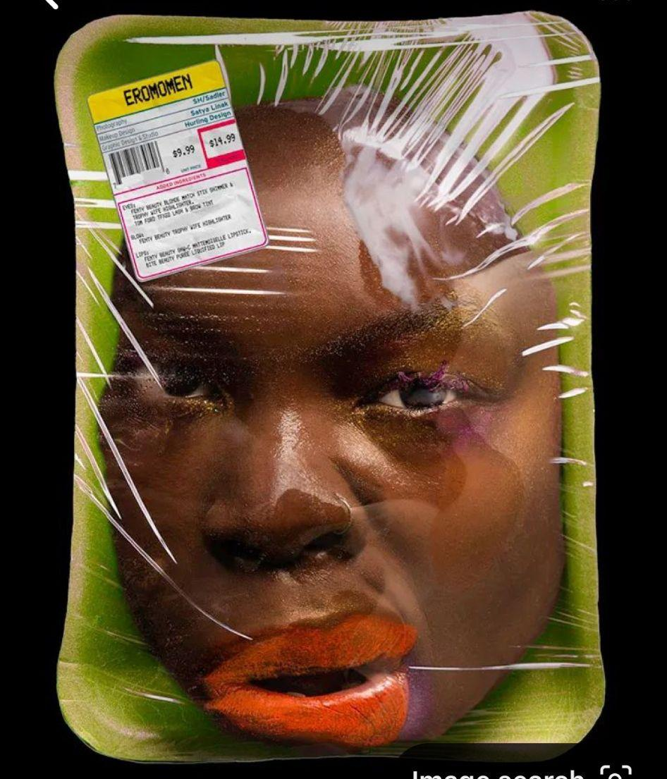
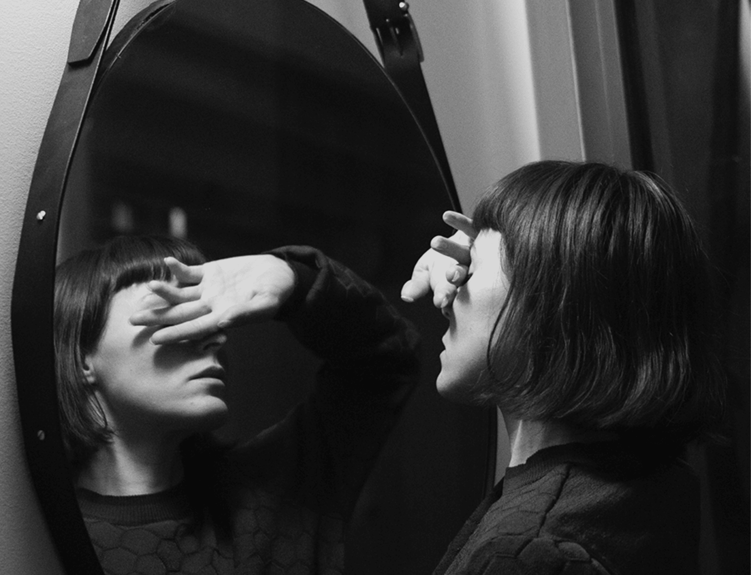
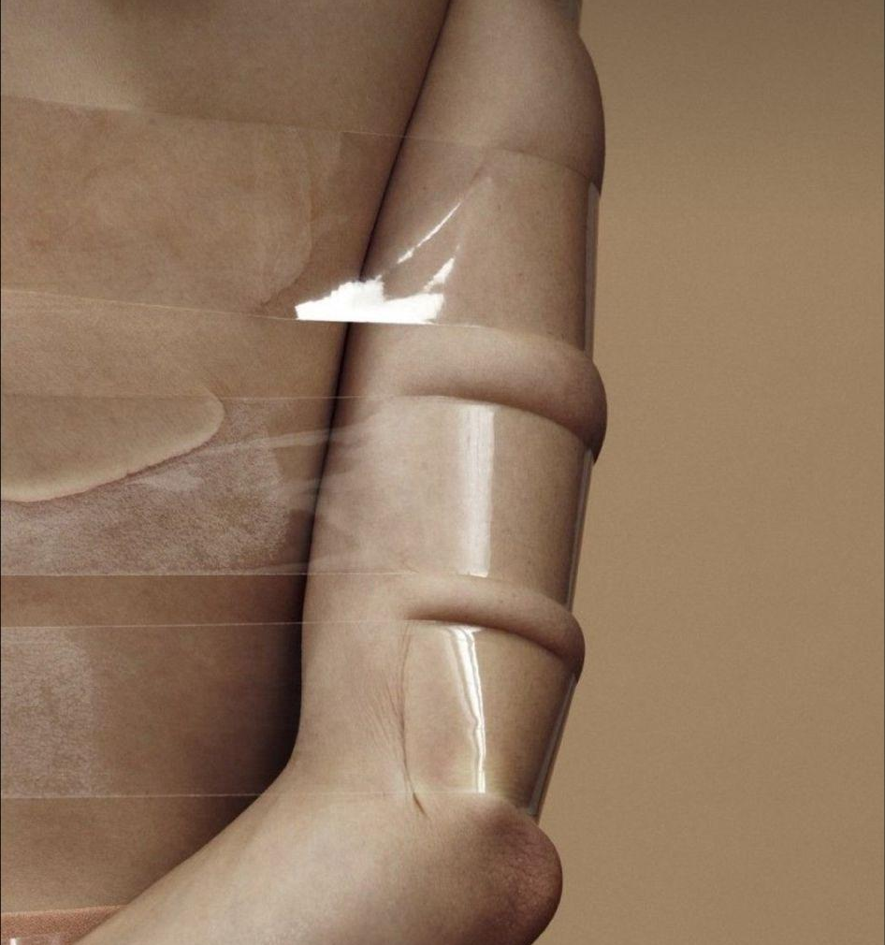
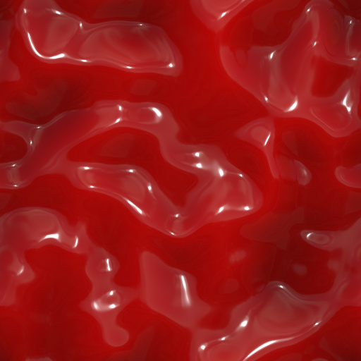
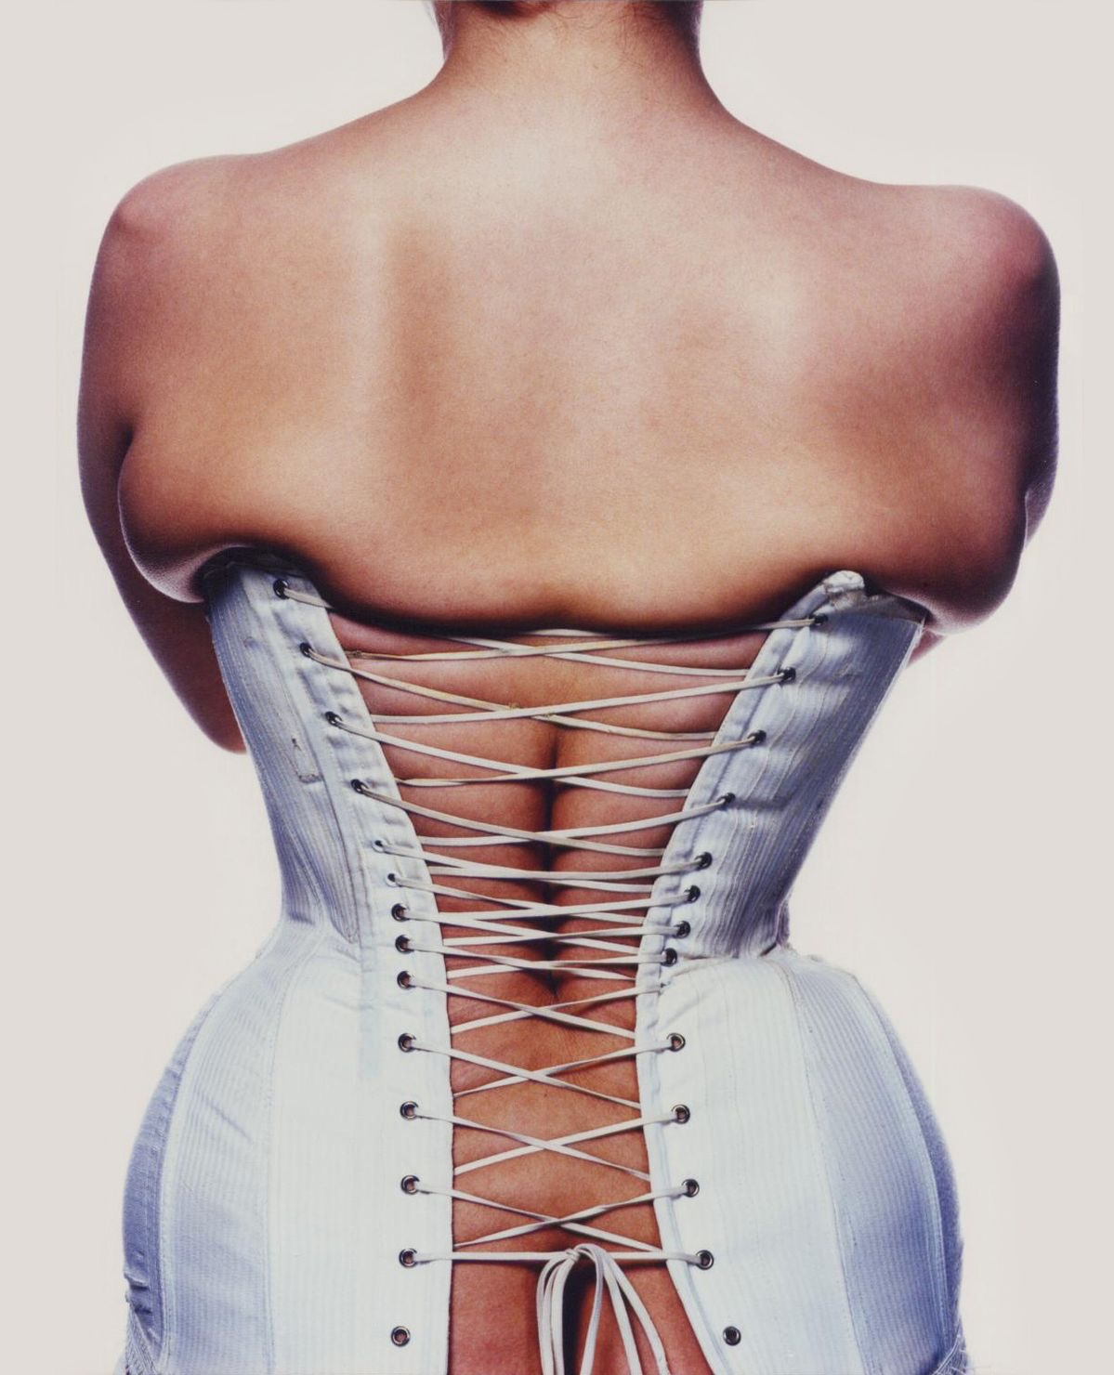
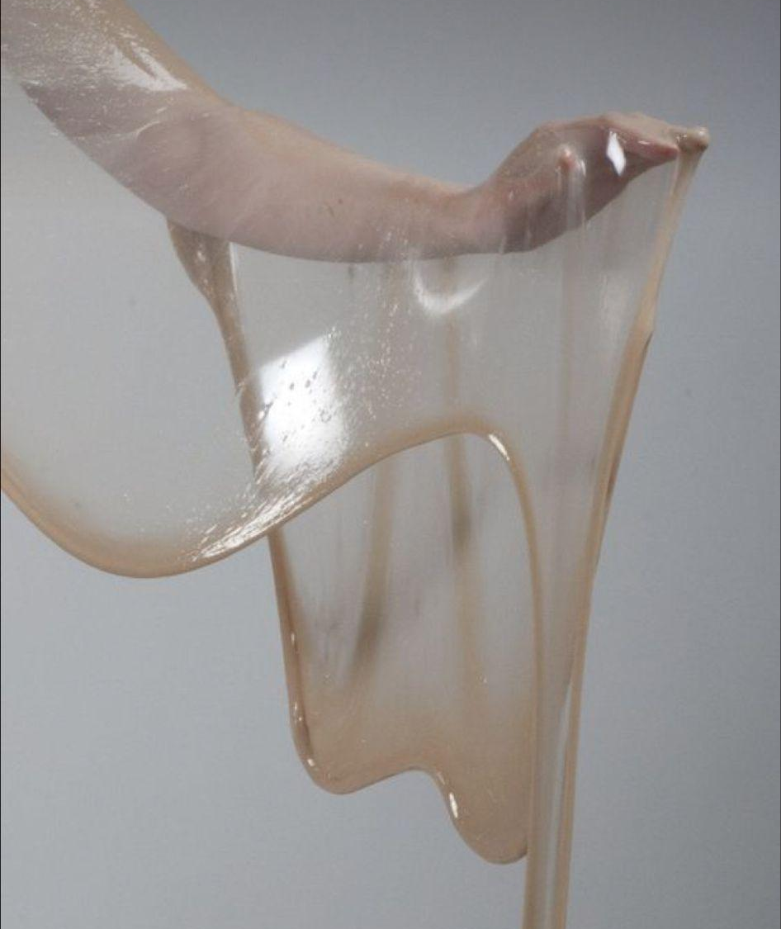
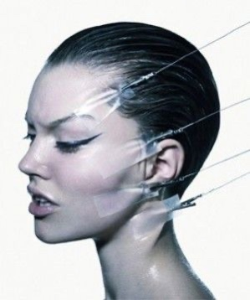
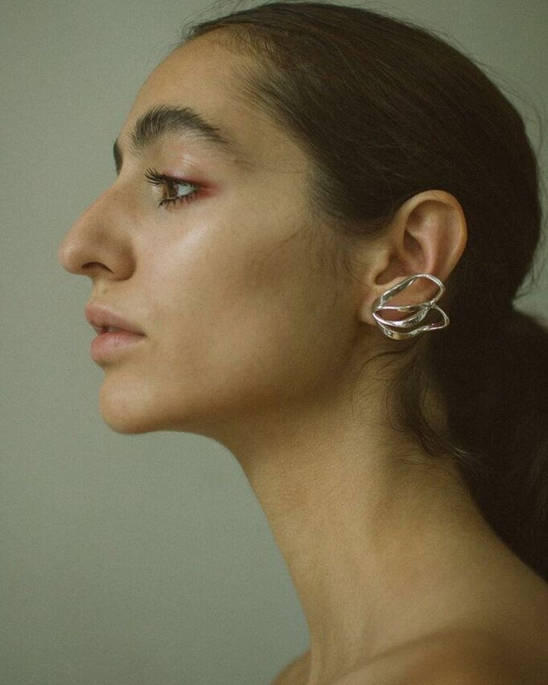
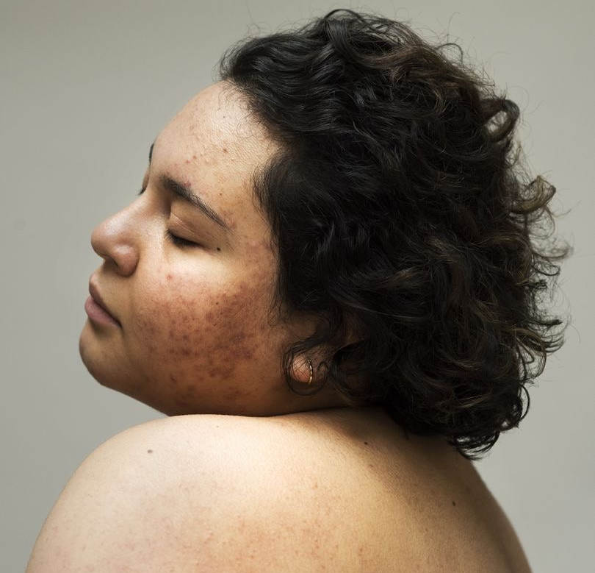
Unapologetically authentic
MELTING
Authenticity
transcendent

Slide 5
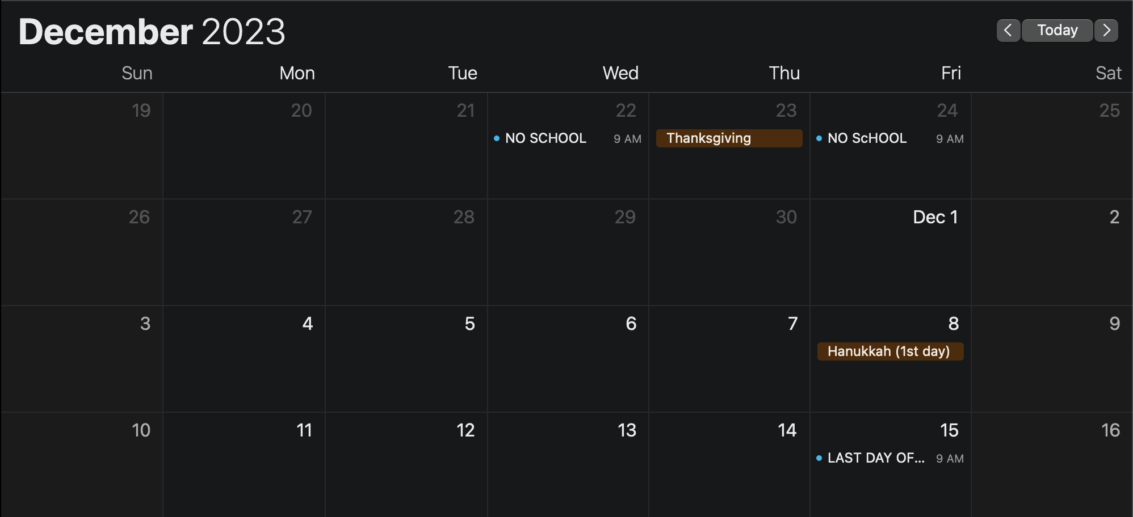
Planning
Shoot day
Shoot day
← No school →
Develop FIlm day 2 (if needed)
Shoot day
Develop FIlm
Print Day
Print Day
Print Day
Print Day
Final Class

Slide 6
CONCLUSION
What are your thoughts?
Any statements about perfectionism?
Feedback on how I can make this not a cheesy overly conventional shoot

